Slide 1



Java Basics
Java Syntax, Conditions, Loops, Methods
Java
Basics
Georgi Novakov
Develop Soft CEO
Software University
http://softuni.bg

Slide 2


Table of Contents
Welcome to Java
Variables and Operators
Conditions: if-else, switch
Loops: for, while, do-while, …
Methods, parameters, return value
Arrays and Collections: ArrayList, Map, Set

Slide 3
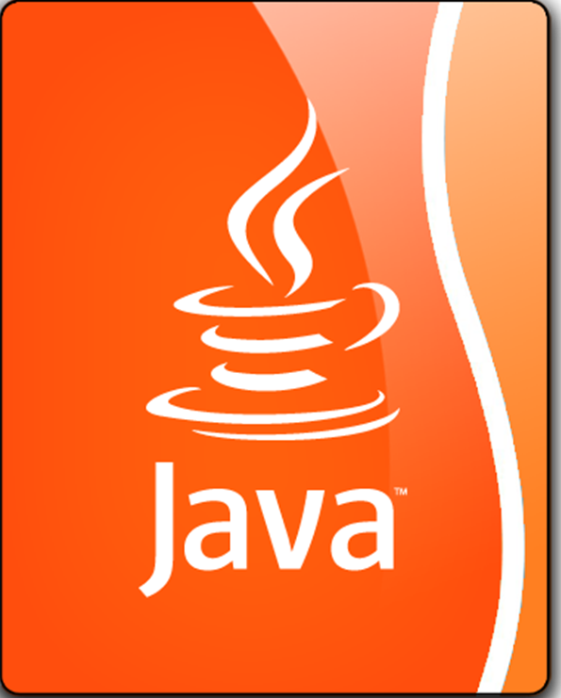
Welcome to Java
Java is a statically-typed, object-oriented programming language
Programs are compiled before execution
Variables' types cannot be changed
In contract, JavaScript and PHP are dynamically-typed (scripting) languages
No compilation, just execute commands

Slide 4
Hello World in Java
HelloJava class always stays in a file named HelloJava.java
HelloJava.java
The { stays at the same line
public class HelloJava {
public static void main(String[] args) {
System.out.println("Hello Java!");
}
}
Program entry point: main()

Slide 5
Java Platform
Java EE vs Java SE vs Java ME

Slide 6
Main Java components
Java Class
Compilation to Bytecode
Java Virtual Machine (JVM) – Java’s heart
HelloJava.java
------------------------------------------------------
public class HelloJava {
public static void main(String[] args) {
System.out.println("Hello Java!");
}
}
HelloJava.class
------------------------------------------------------
010111010101010101010111100010101010101100100101101101010101101011010101011111010100100101001010101011110110110110110111010110110110111010011010011101101011011011
010101101011010101011111010100100101001010101011110110
Compilation
Execution

Slide 7
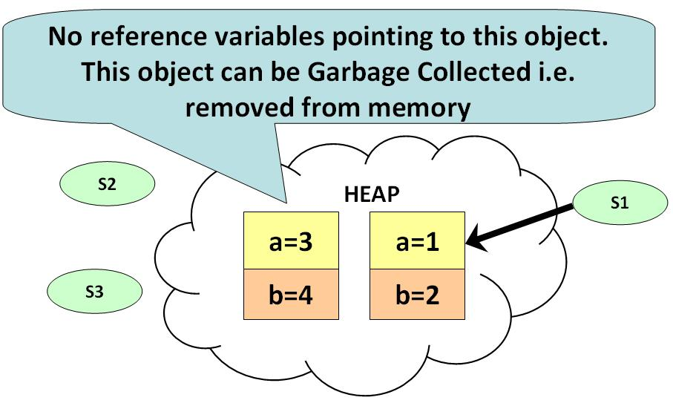
Garbage Collector - automatic memory management

Slide 8
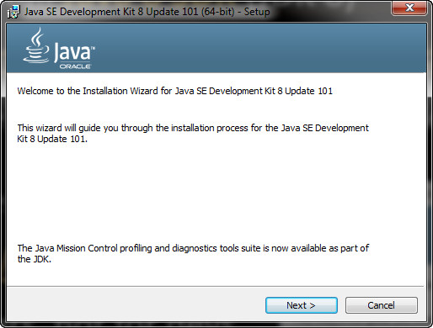
Installing Java
Download and install Java 8 SDK (JDK 8)
http://oracle.com/technetwork/java/javase/downloads/
Provides runtime environment (JRE) + compilers + tools
JRE (Java Runtime Environment)
https://java.com/en/download/
JRE is for end-users, not for devs
Developers should use JDK

Slide 9
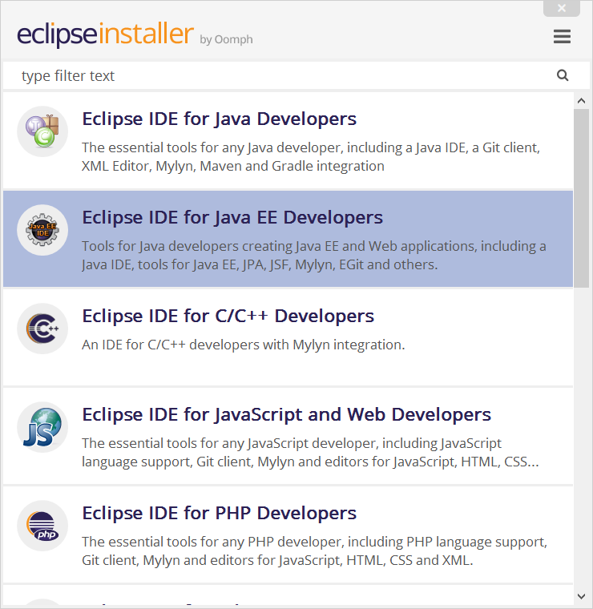

Eclipse for Java EE
Eclipse is open-source Java / Java EE / PHP / C++ IDE
https://www.eclipse.org/downloads/eclipse-packages
Install Eclipse for Java EE /

Slide 10
Variables in Java
Primitive variables
byte centuries = 20; //Declare some variables
short years = 2000;
int days = 730480;
long hours = 17531520;
//Print result to console
System.out.println(centuries + “ centuries is " + years + “ years is ” + days + “ days, or ” + hours + “ hours.”);
The ; separates multiple statements
Print result
float floatPI = 3.14f;
double doublePI = 3.14;
Notes:
Java е типизиран език
Обяснение за print-а
Всяка променлива имам подразбиращ се тип

Slide 11
Variables in Java
Strings
Objects
String str = "Hello";
str = str + " Java";
System.out.printf("str = %s", str); // str = Hello Java
The %s is a string placeholder
Object container = 5;
Object container = “five”;

Slide 12
Variables Range
Type | Contains | Default | Size | Range
boolean | true or false | false | 1 bit | NA
char | Unicode character | \u0000 | 16 bits | \u0000 to \uFFFF
byte | Signed integer | 0 | 8 bits | -128 to 127
short | Signed integer | 0 | 16 bits | -32768 to 32767
int | Signed integer | 0 | 32 bits | -2147483648 to 2147483647
long | Signed integer | 0 | 64 bits | -9223372036854775808 to 9223372036854775807
float | IEEE 754 floating point | 0.0 | 32 bits | ±1.4E-45 to ±3.4028235E+38
double | IEEE 754 floating point | 0.0 | 64 bits | ±4.9E-324 to ±1.7976931348623157E+308

Slide 13
Problem: Calculate Expression
Write a Java program to calculate and print the value of the following expression: [(30 + 21) * 1/2 * (35 - 12 - 1/2)]²
Sample solution:
double val = (30 + 21) * 1/2.0 * (35 - 12 - 1/2.0);
double valSquare = val * val;
System.out.println(valSquare);

Slide 14
Problem: Sum Two Numbers
Write a Java program to sum two real numbers:
import java.util.Scanner;
public class SumTwoNumbers {
public static void main(String[] args) {
Scanner scan = new Scanner(System.in);
double num1 = scan.nextDouble();
double num2 = scan.nextDouble();
System.out.printf("Sum = %.2f", num1 + num2);
}
}

Slide 15
Conditions: if-else Statement
Java implements the classical if / if-else statements:
int number = 5;
if (number % 2 == 0) {
System.out.println("Even number");
}
else {
System.out.println("Odd number");
}

Slide 16
Conditional Operator ( ? : )
variable x = (expression) ? value if true : value if false
int a, b;
a = 10;
b = (a == 1) ? 20 : 30;
System.out.println( "Value of b is : " + b );
b = (a == 10) ? 20 : 30;
System.out.println( "Value of b is : " + b );

Slide 17
Beware of Comparing Strings
String s = "sho"; if ("Pesho" == "Pe" + s) { System.out.println("Здрасти, Пешо!"); }
VS
String s = "sho"; if ("Pesho".equals("Pe" + s)) { System.out.println("Здрасти, Пешо!"); }

Slide 18
The switch-case Statement
Selects for execution a statement from a list depending on the value of the switch expression
int day = 3;
switch (day) {
case 1: System.out.println("Monday"); break;
case 2: System.out.println("Tuesday"); break;
case 3: System.out.println("Wednesday"); break;
…
case 7: System.out.println("Sunday"); break;
default: System.out.println("Error!"); break;
}

Slide 19
Loops: for, while, do-while, …
The for / while / do-while loops work as in C++, C# and Java
for (int i = 0; i <= 10; i++)
System.out.println(i); // 0 1 2 3 4 … 10
int count = 1;
while (count < 1024)
System.out.println(count *= 2); // 2 4 8 … 1024
String s = "ha";
do { System.out.println(s); s = s + s; }
while (s.length() < 10); // ha haha hahahaha

Slide 20
Problem: Sum N Integers in Java
import java.util.Scanner;
public class SumIntegers {
public static void main(String[] args) {
Scanner scan = new Scanner(System.in);
int n = scan.nextInt();
long sum = 0;
for (int i = 0; i < n; i++)
sum += scan.nextInt();
System.out.println("Sum = " + sum);
}
}
5
10
20
30
40
-1
99

Slide 21
Methods in Java
Methods in Java hold a named piece of code
Can take parameters and return a result (strongly typed!)
Similar to functions in C / PHP / JS and methods in C++ / C#
static makes the method callable from main()
static int multiply(int a, int b) {
return a * b;
}
System.out.println(multiply(2, 3)); // 6 == 2 * 3
System.out.println(multiply(5)); // Compilation error

Slide 22

Strings
Strings in Java
Know their number of characters: length()
Can be accessed by index: charAt(0 … length()-1)
Reference types
Stored in the heap (dynamic memory)
Can have null value (missing value)
Strings cannot be modified (immutable)
Most string operations return a new String instance
StringBuilder class is used to build stings

Slide 23
Strings – Examples
String str = "SoftUni";
System.out.println(str);
for (int i = 0; i < str.length(); i++) {
System.out.printf("str[%d] = %s\n", i, str.charAt(i));
}
System.out.println(str.indexOf("Uni")); // 4
System.out.println(str.indexOf("uni")); // -1 (not found)
System.out.println(str.substring(4, 7)); // Uni
System.out.println(str.replace("Soft", "Hard")); // HardUni
System.out.println(str.toLowerCase()); // softuni
System.out.println(str.toUpperCase()); // SOFTUNI

Slide 24
Strings – Examples (2)
String firstName = "Steve";
String lastName = "Jobs";
int age = 56;
System.out.println(firstName + " " + lastName +
" (age: " + age + ")"); // Steve Jobs (age: 56)
String allLangs = "C#, Java; HTML, CSS; PHP, SQL";
String[] langs = allLangs.split("[, ;]+");
for (String lang : langs) {
System.out.println(lang);
}
System.out.println("Langs = " + String.join(", ", langs));
System.out.println(" \n\n Software University ".trim());

Slide 25
Arrays in Java
// Array holding numbers
int[] numbers = {1, 2, 3, 4, 5};
System.out.println(Arrays.toString(numbers));
// Array holding strings
String[] weekDays = {"Monday", "Tuesday", "Wednesday",
"Thursday", "Friday", "Saturday", "Sunday"};
// Array of mixed data (objects)
Object[] mixedArr = {1, new Date(), "hello"};
// Array of arrays of strings (matrix)
String[][] matrix = {
{"0,0", "0,1", "0,2"},
{"1,0", "1,1", "1,2"}};

Slide 26
Processing Array Elements
String[] capitals =
{"Sofia", "Berlin", "London", "Paris", "Moscow"};
capitals[0] = "SOFIA";
capitals[4] = null;
System.out.println(Arrays.toString(capitals));
// [SOFIA, Berlin, London, Paris, null]
for (String capital : capitals)
System.out.println(capital);
for (int i = 0; i < capitals.length; i++)
System.out.println(capitals[i]);
Traditional foreach loop
Traditional for-loop

Slide 27
Collections: ArrayList<String>
ArrayList<String> names = new ArrayList<String>() {{
add("Peter");
add("Maria");
add("Katya");
add("Todor");
}};
names.add("Georgi"); // Peter, Maria, Katya, Todor, Georgi
names.remove(0); // Maria, Katya, Todor, Georgi
names.remove(1); // Maria, Todor, Georgi
names.remove("Todor"); // Maria, Georgi
names.addAll(Arrays.asList("Alice", "Tedy"));
// Maria, Georgi, Alice, Tedy
names.add(3, "Sylvia"); // Maria, Georgi, Alice, Sylvia, Tedy
names.set(2, "Mike"); // Maria, Georgi, Mike, Sylvia, Tedy
System.out.println(names);

Slide 28
Collections: ArrayList<Integer>
// This will not compile!
ArrayList<int> intArr = new ArrayList<int>();
ArrayList<Integer> nums = new ArrayList<>(
Arrays.asList(5, -3, 10, 25));
nums.add(55); // 5, -3, 10, 25, 55
System.out.println(nums.get(0)); // 5
System.out.println(nums); // [5, -3, 10, 25, 55]
nums.remove(2); // 5, -3, 25, 55
nums.set(0, 101); // 101, -3, 25, 55
System.out.println(nums); // [101, -3, 25, 55]

Slide 29
HashSet<E> and TreeSet<E>
Set<String> set = new TreeSet<String>();
set.add("Pesho");
set.add("Tosho");
set.add("Pesho");
set.add("Gosho");
set.add("Maria");
set.add("Alice");
set.remove("Pesho");
System.out.println(set); // [Alice, Gosho, Maria, Tosho]

Slide 30
Collections: Maps in Java
Maps in Java keep unique <key, value> pairs
HashMap<K, V>
Keeps a map of elements in a hash-table
The elements are randomly ordered (by their hash code)
TreeMap<K, V>
Keeps a set of elements in a red-black ordered search tree
The elements are ordered incrementally by their key

Slide 31
HashMap<K, V> – Examples
Counting words occurrences in a list:
String[] words = { "yes", "hi", "hello", "hi", "welcome",
"yes", "yes", "welcome", "hi", "yes", "hello", "yes" };
Map<String, Integer> wordsCount = new HashMap<String, Integer>();
for (String word : words) {
Integer count = wordsCount.get(word);
if (count == null) {
count = 0;
}
wordsCount.put(word, count+1);
}
System.out.println(wordsCount); // {hi=3, yes=5, hello=2, welcome=2}

Slide 32
TreeMap<K, V> – Examples
Students and their grades
HashMap<String, ArrayList<Integer>> grades = new HashMap<>();
grades.put("Peter", new ArrayList<>(Arrays.asList(5)));
grades.put("George", new ArrayList<>(Arrays.asList(5, 5, 6)));
grades.put("Maria", new ArrayList<>(Arrays.asList(5, 4, 4)));
grades.get("Peter").add(6);
grades.get("George").add(6);
for (String key : grades.keySet()) {
System.out.println("" + key + " -> " + grades.get(key));
}

Slide 33
Problem: Sums by Town
You are given a sequence of lines, each holding town + income
Write a Java program to sum the incomes for each town
Sofia | 200
Varna | 120
Pleven | 60
Varna | 70
Towns can appear multiple times
Pleven -> 60
Sofia -> 200
Varna -> 190
Order the towns by name

Slide 34

Summary
Java is a statically-typed language
Java programs consist of classes
Program logic (variables, conditions, loops) are similar to C# / C++ / PHP / JavaScript
Arrays in Java hold sequences of elements
Java collections: list, set, map { key → value}
Objects in Java are class instances
Java is object-oriented language: relies on objects, classes, interfaces, methods, etc.

Slide 35






Free Trainings @ Software University
Software University Foundation – softuni.org
Software University – High-Quality Education, Profession and Job for Software Developers
softuni.bg
Software University @ Facebook
facebook.com/SoftwareUniversity
Software University @ YouTube
youtube.com/SoftwareUniversity
Software University Forums – forum.softuni.bg

